Slide 1
Welcome to Fidato Creations
Web design and development company, Delhi
http://www.fidatocreations.com/

Slide 2
PREFACE
About Us
Our Vision
Why Choose Us
Technologies
Clients
Our Services
Contact Us

Slide 3
About Us
Fidato Creations is a leading website designing and development company based in Delhi, India since 2016. We have a great expertise of Web, graphic, 3D and digital marketing services. our team of developers has set new benchmarks in the industry. We have consistently maintained a high standard of delivery for our cost-effective solutions. Our creative team works with a diverse range of clients. By combining art and technology, we deliver an effective Internet presence. Within a short span of 2 years, we have 30+ satisfied clients across the globe with 50+ projects delivered successfully.
Know More About us Visit: http://www.fidatocreations.com/aboutus.html

Slide 4
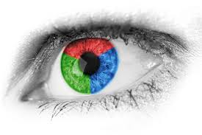
Our Vision
The highly professional team of Web Developers, Web Designers and SEO experts, at Fidato Creations has this unique vision of placing their clients in the league of digitally developed establishments. We aim at fostering growth in the best possible way.
We don’t create traditional websites. We develop lead generating machines so that your business moves to next level.
We do hard work in building our reputation within the industry, and develop good connections with our clients to understand their requirements.

Slide 5
Why Choose Us
Fidato Creations stands for impeccable web designs and digital marketing solutions. Fidato’s web development services cover impressive clientele and a wide reach. We offer value-added services and benefits, including:
24/7 support
Innovative web designing and development
Professional coding and layouts
Intuitively designed sites with unique and optimized graphics
Lead generation and prospect management
Committed and trained professionals

Slide 6
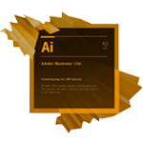
Technologies
GRAPHICS TECHNOLOGY
WEB TECHNOLOGY
3D TECHNOLOGY

Slide 7
Clientele
Our Valuable Clients

Slide 8
Our Services
Web Designing
Web Development
Software Development
App Design and Development
Graphic Designing
Digital Marketing
3D Design

Slide 9
We Thank You !
We appreciate and thank you for going through our company profile.
If there are any questions or feedbacks
Please Contact Us
Fidato Creations
Address: D-20, First Floor, Kiran Garden, Uttam Nagar, Delhi
Website: http://www.fidatocreations.com/
Call on: 9899442777
Email at: info@fidatocreations.com

